Slide 1
Social media & career mobility
Day two
Eliza greenwood
@E_lizaG

Slide 2
Reminder
Hashtag is #LCBSM

Slide 3
Terminology to note
Social Media Channel
KPIs
Pain – points
Brand
Audience
Metrics
Influencer
Target
Call to Action (CTA)
“A11y”
“So-Me” or “SoMe”
PWD
Network
Longtail
Career Mobility
Keyword
Listening
HTML
Handle

Slide 4
Asserting your “brand”
Channel ratios
Keep in mind
Facebook
at least half personal
¼ self promotion
Listening (commenting, liking, sharing) 2/3, posting my own content 1/3.
Twitter
One of every 5 or 10 personal
4/5 Listening
1/5 self promotion
LinkedIn
99% professional content (rarely see baby or wedding announcements here, for example)
¼ original
¾ Listening
Moving target.
Watch competitors
Keywords
CTAs
KPI’s

Slide 5
Recap - Discussion
Review
Pair share?
Questions?
Surprises?
Expectations?
Parking Lot?
Is this guaranteed to get you a job?
Share your personal statement with a partner

Slide 6
Be a sophisticated user!
Cautionary Tales
My example – Red Solo Cup – my hair stylist
Misrepresenting an org – SearchFest embarassment
Sharing about bad work behavior/attitudes – interpreters
Oxygen: 8 Insane Social Media Posts That Got People Fired
Huffington Post: Fired Over Facebook
It is too easy to take things out of context in writing.
Pay attention to changing trends and engagement
Authenticity and consistency is key – the stronger your brand, the closer you are to getting that interview.
Go directly to the source with a complaint before airing it publicly.
Don’t feed inflammatory threads.

Slide 7
Take Stock
Where is the big foot in your life?

Slide 8
Research
How do you measure up?

Slide 9
What can you find online about your targets and competitors?
Review your list of who you know or can find along that path and make a plan for how to reach out to each of them this year.
Use your list - what trends did you spot?
What about Big Foot? Big fish/small pond or vice-versa?
Notice any keywords?

Slide 10
Bonus: Engage on Social Media
Twitter
Reply to, fav or RT (retweet) any of my posts – use #LCBSM and @TheLCB1985
Follow LCB
LinkedIn
Comment on, like or share any of my recent posts
Follow LCB
Facebook
Comment, like or share any of my (public) posts
Follow LCB

Slide 11
Reverse engineer: Find keywords on postings then compare with people with those titles
Find keywords on postings
Compare to people in those fields
Social Media
LinkedIn
Twitter
Facebook
Sites
Craigs List
Monster.com
Indeed.com
TheMuse.com
Peers
Colleagues
Potential Bosses
Mentors
Mentees

Slide 12
*Gap Analysis – audit
Target
How do you describe their brand?
What is their social media presence?
Did you learn anything new?
You
What channels are you on?
What topics are you posting about?
What kind of KPIs do you want to start tracking?
Them
What channels are your competitors on?
What topics are they posting about?
What are their posting ratios?

Slide 13
Accessibility & advocacy
Who are you?

Slide 14
accessibility
workarounds
pitfalls
Facebook
Twitter
LinkedIn
Twitter
Some features are available on desktop but not iPhone

Slide 15
#a11y publishing Pro-tips
Across channels
Work in captions/image descriptions.
Provide transcripts and captions.
Avoid abbreviations.
Know your audience.

Slide 16
#a11y publishing Pro-tips
Facebook-
Link to transcript for videos
Refer to YouTube for videos
YouTube-
Provide audio descriptions
Beware of auto-play
Twitter -
Hashtags
Put them all at the end?
Camel case – see my tweet example
LinkedIn-
Accessible PDFs
Who isn’t “at the table?”
Instagram-
Who isn’t “at the table?”

Slide 17
Self Advocacy Badge
“policing”
Threatening
Coming out as blind
Finding that sweet spot
Example: AU – festivals
Coming out as blind

Slide 18
Approach 2: Covert
pros
cons
Get foot in the door on merit – no cause for discrimination
Can be awkward when it does come time
May feel disengenous
Not easy for everyone to accomplish with a profile picture.

Slide 19
Approach 1: overt (cory Klatik)
Twitter – profile URL has the word “blind” in it
LinkedIn – “blindness” in summary and experience
Facebook - Posts talk about accessibility and his own blindness.
Uses it on cover letter *if* it will help him get the job.

Slide 20
Approach 1: overt
pros
cons
Get it out of the way
Automatically screens out the “jerks”
Missed opportunity

Slide 21
Approach 1: hybrid content but not profile (Terry Bray)
Twitter – no explicit mention of blindness but some tweets/content about it
LinkedIn – “blindness” in experience
Facebook – no public posts except picture – can tell he is blind

Slide 22
Approach 3: hybrid – content but not profile
pros
cons
Authentic
May be registering for people who are reading more carefully.
Still risk in discrimination

Slide 23
influencers
Aligning with existing and new connections

Slide 24
Social media networking
Pyramid of favors –
Share an article of interest
Quick question
Review work sample
10 minute phone call
lunch
My own Example
SEO colleagues
Potential employers (2)
SEO Nerd
Study buddies
Pro-tip for reaching out cold
Try making contact with someone at your level or slightly above you, rather than the person who would be your boss.

Slide 25
Peers, Colleagues, Potential Bosses
Quick, easy back-scratching
Like dating
Include a question or CTA

Slide 26
Social media bean
10 jelly beans each – where will you allocate your time?
Post original content | Engage in listening | Engage in networking
Skilled with Twitter | Skilled with Facebook | Skilled with LinkedIn
1:1 time –
Aleeha
Bobbi Pompey
Ralab

Slide 27
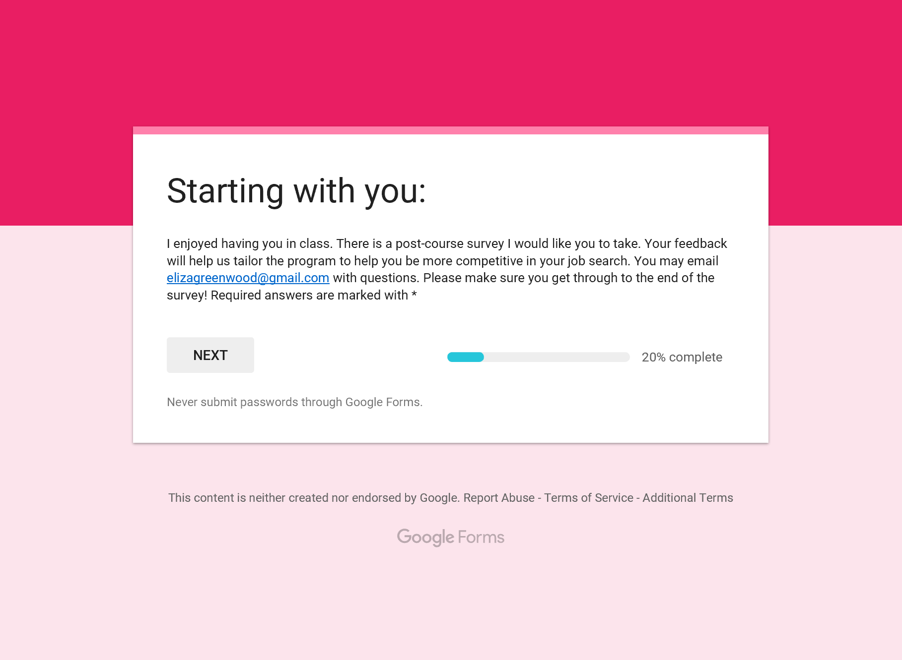
Post course feedback
Incentive: I have more content coming – need testers – willing to trade. Look for follow-up email.
1:1 feedback –
Aleeha
Bobbi Pompey
Ralab

Slide 28
Reality check: how did we do?
Do you now?
Was this course
Have a deeper understanding of the social media channels?
Have a better sense of control for your profiles?
Feel you can manage first impressions with your “brand”?
Use social media for career mobility?
Fun?
Interactive?
Not completely polished?
Leave unanswered questions?
Get you to say silly things like “cheese” and “big foot?”
Have prizes?
Empower you to build community around yourself that supports you and believes in you?

