Slide 1
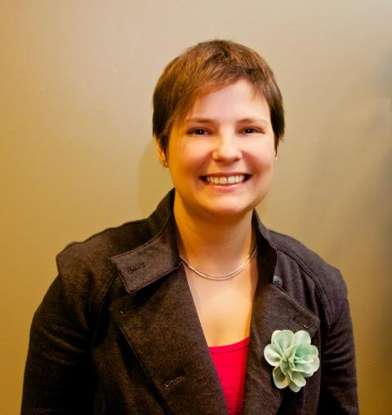
Social Media Accessibility
Importance for Professionals & Jobseekers
Eliza Greenwood
Digital Marketer
Portland, Oregon
CSUN - March 2016

Slide 2
Hi, I’m Eliza
I like to hustle

Slide 3
Former sign language interpreter and documentary filmmaker
Austin Unbound (2011)
Digital Marketer
Social media
Analytics
PPC Advertising
Late Marketing Manager @AccessibilityOz
Practiced accessibility across online presence
#A11y Evangelist
CSUN 2015
Marketers in Portland
My own social channels
www.elizagreenwood.com/blog

Slide 4
presentation objective
Provide insight for strategic implementation across social media channels
Includes
Reaching your audience(s) where they are
Making your channel(s) more accessible
Useful for
Jobseekers
Professionals
Organizations
Question: Is it ok to segment different channels by type of disability?

Slide 5
This presentation
Will invite you to engage with the group/someone next to you
Will NOT
Focus on major technical issues for individual social media platforms
Terms
“a11y” - digital accessibility
“SoMe” - social media
“DHH” - Deaf & Hard of Hearing
Questions?

Slide 6
Social media savvy?
Your Best Guess
Most popular channel among job recruiters?
LinkedIn
Facebook
Twitter
% Job recruiters who do NOT use social media in hiring?
Shout out your guesses!

Slide 7
Social media shockers
Job Recruiter Use
Only 4% don’t use social media in hiring
Channel breakdown
LinkedIn 87%
Facebook 55%
Twitter 47%
Glassdoor 38%
YouTube 21%
Google+ 14%
Tweet #SoMeA11y with one thing you have learned!

Slide 8
Social media stats
Hiring
73% of hiring managers have hired through social media
55% of HR managers say they’ve reconsidered a hire based on content found on a candidate’s social media presence
Looks like it may be time to start setting-up those profiles!

Slide 9
Social media shockers
Jobseeking
79% of job seekers use social media in their job search
31% of job seekers reported finding a job through Instagram!
SoMe not just for jobseeking - it permeates our lives

Slide 10
(UN)Employment Statistics
February 2016 – Department of Labor
Unemployment Rate
People with disabilities 12.5%
People without disabilities 4.9%

Slide 11
Employment Statistics
Disability Compendium – 2014 (ages 18-64 living in the US)
Civilians with Disabilities
34.4% employed
Civilians with Vision Disabilities
40.2% employed
Civilians with Hearing Disabilities
50.7% employed

Slide 12
Check-in
Questions?
How are we doing?

Slide 13
Survey time!
Eliza with two survey respondents – John & Larry Gassman CSUN 2015

Slide 14
Social media accessibility Survey - methodology
Why/how/who?
When/where?
I live online and wanted a pulse
Used as an engagement strategy
Reviewed by Whitney Quesenbery (UXer – Center for Civic Design)
Targeting CSUN & Personal Social Networks
Opened 3/4/15
Survey link tweeted out throughout conference
Flyers with link passed out to anyone/everyone
Live for 3 weeks
Shared via personal social media networks
Emailed reminder to 41 contacts

Slide 15
Social media accessibility Survey - methodology
Engagement
Views
Bit.ly link
241 total clicks
32 via Facebook
20 via LinkedIn
78 via Twitter
102 other/unknown
53 retweets
111 completed surveys
Self described disabilities were grouped:
18 DHH
27 Blind
10 Vision
12 None
10 Other Disability
34 Declined to Answer

Slide 16
Link to survey at elizagreenwood.com/social-media-a11y
Facebook – high among DHH
Twitter – high among blind/vision, low among DHH
LinkedIn – high among vision impairments, low among Deaf
Instagram – low among blind, high among DHH

Slide 17
Types of technical solutions that would make social media more accessible, in general.
Summary
High to moderate desire for image descriptions/keyboard navigation.
Vision impairment a consistent but gentler slope
Desire for captions is moderate across groups, high among DHH

Slide 18
Postulation
Vision Impairment
Deaf/Hard of Hearing
Microsoft study interesting – poorer experience on Twitter platform since 2011 when pictures were enabled.
Sample 756 tweets with embedded images
61.8% tweets poor captions
27% tweets minimally acceptable captions
11.2% good captions
German study published 2010 on Web 2.0 found low use of wikis among Deaf population
“Literary publications, exchange of views and discussions are not part of Deaf culture.”

Slide 19
Fast pair/share
Survey snippets - cons
I see the benefits of it.... I think I just feel overwhelmed with words, vocabulary, and stuff like that... (DHH – about LinkedIn)
YouTube auto captioning is an insult to my culture. If technology cannot be improved to the point where captioning is legible, it should be abandoned.
Poor keyboard/screen reader accessibility on Facebook, dreadful keyboard/screen reader accessibility on LinkedIn.
What is your #1 social media accessibility pet peeve?

Slide 20
#a11y publishing Pro-tips
Across channels
Work in captions/image descriptions.
Provide transcripts and captions.
Avoid abbreviations?
Know your audience.
Facebook-
Link to transcript for videos
Refer to YouTube for videos
YouTube-
Provide audio descriptions
Beware of auto-play
Twitter -
Hashtags
Put them all at the end?
Camel case – see my tweet example
LinkedIn-
Accessible PDFs
Who isn’t “at the table?”
Instagram-
Who isn’t “at the table?”

Slide 21
References - Mind the gap!
Social Media & HR
Unemployment statistics
https://blog.workable.com/2016-social-recruitment-trends-forecast/
http://www.careerarc.com/blog/2016/01/13-recruiting-stats-hr-pro-must-know-2016/
http://www.socialtalent.co/blog/how-recruiters-and-job-seekers-use-social-media-in-2015
http://www.adecco.com/industry-insights/work-trends-blog/how-do-recruiters-use-socialnetworks.aspx
http://www.blogging4jobs.com/social-media/6-shocking-job-search-statistics-im-discussing-at-sxswi/#VXzJDDDVtpABBifJ.97
http://www.dol.gov/odep/
http://www.disabilitycompendium.org/statistics/employment

Slide 22
More resources for chipping away at #SoMe #a11y
Oct 2015 Social media & accessibility webinar by Gian Wild
http://dev.accessibilityonline.org/ADA-Audio/archives/110405
2015 CSUN slides “An Improved Website Design for Elders Utilizing Social Media” by Jessica ArFaa & Yuanqiong (Kathy) Wang – Towson
2013 slides “Social Media Streaming Research” by Accessible Media Inc.
2010 “Web 2.0 Barrierefrei” study by Aktion Mensch
www.einfach-fuer-alle.de/studie/
2016 CSUN preso by Jennie Delisi & Jay Wyant - more geared towards Gov’t agencies
2016 “Understanding Twitter’s Evolving Accessibility to Blind Users” http://research.microsoft.com/en-us/um/people/merrie/papers/twitter_visual_chi2016.pdf by Microsoft
@debraruh (Ruh Global)
@Jennison (LinkedIn)

Slide 23
Vote – Which blog post you would like to read next?
more survey results including types of devices used to access social media- grouped by disability
3 pro tips with fast step-by –step instructions to leverage Linkedin & Facebook for career mobility

Slide 24
Thank you! Please find me on Linkedin & Twitter
elizagreenwood@gmail.com
Elizagreenwood.com

