Slide 1
Social media & career mobility
Day one
Eliza greenwood
@E_lizaG

Slide 2
Intro
Hashtag is #LCBSM

Slide 3
Former sign language interpreter and documentary filmmaker
Austin Unbound (2011)
Digital Marketer
Social media
Analytics
PPC Advertising
Late Marketing Manager @AccessibilityOz
Practiced accessibility across online presence
#A11y Evangelist
CSUN 2015 & 2016
Marketers in Portland
My own social channels

Slide 4
Live in Portland
Love pho & snowshoeing
Just sold house moving to the suburbs with my wife and cat
Quirky sense of humor

Slide 5
This is a two day training
After it is over you can expect to
It also aims to
Have a deeper understanding of the social media channels
Gain a sense of control of your profiles
Improve ways to manage first impressions with your “brand”
Use social media for career mobility
Be fun
Be interactive
Be not completely polished
Leave unanswered questions
Get you saying silly things like “cheese” and “big foot!”
Have prizes
Empower you to build community around yourself that supports you and believes in you

Slide 6
Terminology to listen for and to google – take notes from template at lcb-class-links
Social Media Channel
KPIs
Pain – points
Brand
Audience
Metrics
Influencer
Target
Call to Action (CTA)
“A11y”
“So-Me” or “SoMe”
PWD
Network
Longtail
Career Mobility
Keyword

Slide 7
Branding
Intros & branding
Test - EG
Assert your authentic brand – consistent
Aligning with other brands
Ellen & Oprah
Howard Stern
Malala Yousafzai
What do you know?
Where might you find them?
What are their values?
Do they have a problem you can help solve?

Slide 8
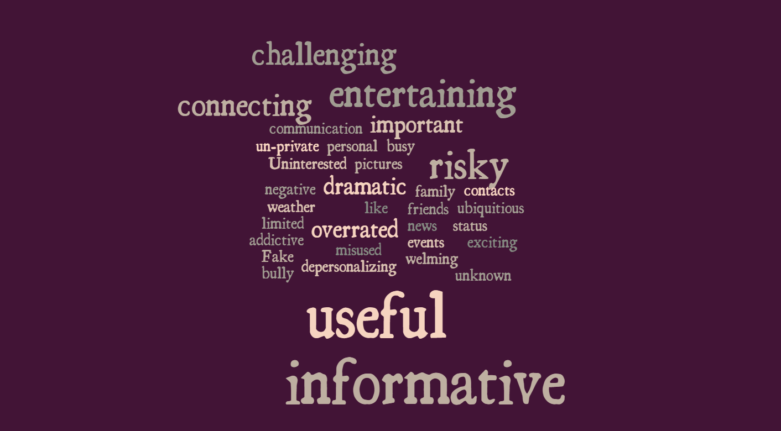
Survey “Top five words”
Word cloud with the words
useful for connecting with people
important, informative, dramatic, busy, connector
friends, events, family, status, contacts
Not really in to it.
cautious, limited, over-exaggerated, benificial, and personal
helpful, networking, enjoyable, relaxing, and funny
overwelming, helpful, informative, resourceful, and over-rated
communication, news, weather, sports, and unknown
un-private, insecuir, depersonalizing, and informative
useful, important,unsafe, informative. drama
like, difficult, pictures, informative, and exciting
informative, frustrating, adictive, ubiquitious, and welming
Fake, bully, negative, informative, stocker
Beneficial, but too often misused.

Slide 9
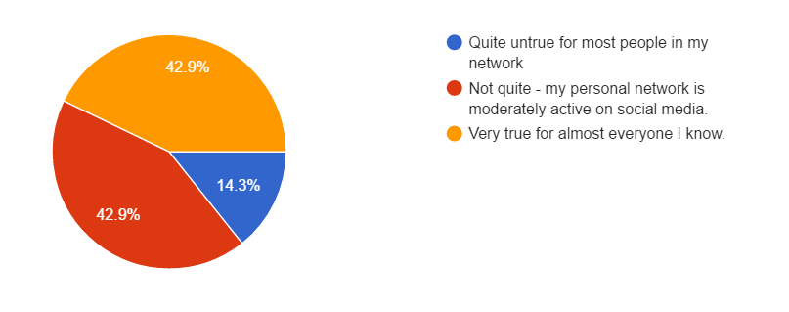
Survey: my personal network is very active on social media
Chart Breakdown
43% - very true for almost everyone
43% moderately true
14% untrue for most people

Slide 10
5 Words
Your home town
Your weekend
Your dream job

Slide 11
Survey: I typically use Facebook
Chart Breakdown
36% never use it
21% less than 1/week
21% 1-2 times/day
14% several times/day
8% 1-2 times/week

Slide 12
Survey: I typically use Twitter
Chart Breakdown
57% never use
21% use it less than once/week
14% use it 1-2 times/week
7% use it 1-2 times/day

Slide 13
Survey: I typically use LinkedIn
Chart Breakdown
64% never use it
29% use it less than once/week
7% use it 1-2 times/day

Slide 14
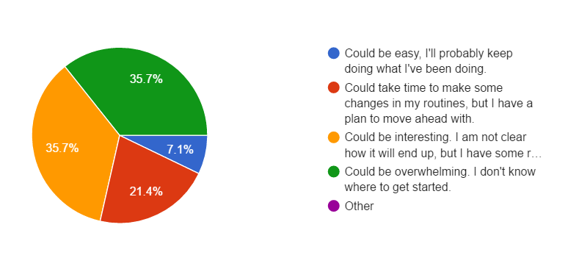
Survey: social media will be
Chart Breakdown
36% interesting, not clear but have resources
36% overwhelming, not sure how
21% need to make routine, have a plan
7% easy – will not change

Slide 15
Social media shockers from SHRM 2015 study
Job Recruiter Use in 2015 84%
Of that, the channel breakdown is:
LinkedIn 96%
Facebook 66%
Twitter 53%
YouTube 11%
Google+ 12%
Tweet #LCBSM with one thing you have learned!

Slide 16
Social media shockers from SHRM 2015 study
The Rest Are:
5% never have used social media and do not plan to.
2% have used it and don’t plan to again
9% haven’t used it but plan to.
Tweet #LCBSM with one thing you have learned!

Slide 17
Social media stats – SHRM continued
Hiring
39% of hiring managers screen using public social media profiles
36% have disqualified job candidates because of concerning info online

Slide 18
Jobseeker stats
79% of jobseekers use social media (2015- Glassdoor)

Slide 19
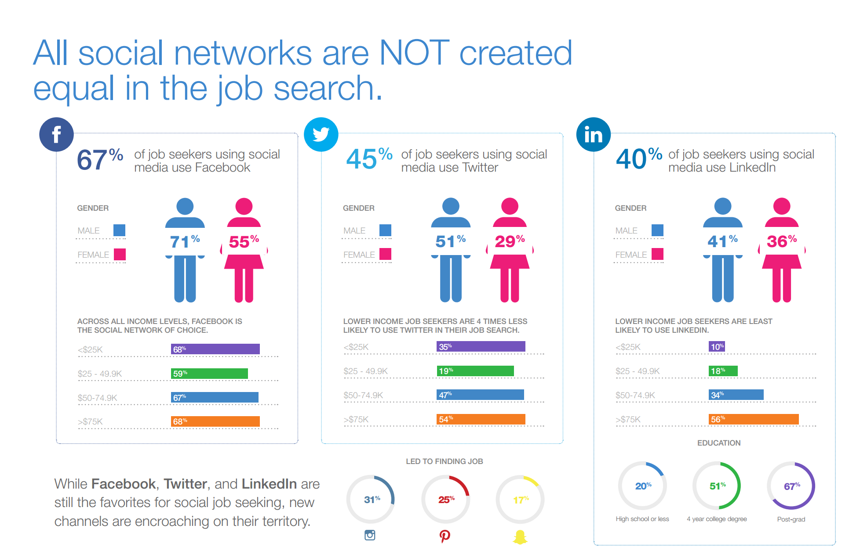
Social media shockers Jobvite data 2015

Slide 20
Dreamtime
Where would you like to be working in 1-3 years?

Slide 21
dreamjob
Where is it, exactly?
What are the must-haves?
How much will you earn?
What will your workspace be like?
What is the company culture like?
Do you know the name of the company?
If you end up there in less or more time will you still be glad you arrived?

Slide 22
Form a plan
What experience can you gain now to get there?
Who do you know along that path?
Classes?
Volunteering?
Networking?
Influencers
Peers
Potential Bosses
Potential Mentors
Potential Mentees

Slide 23
*Gap Analysis – Your guess
Target
How do you describe their brand?
What channels do you guess they are on?
What do you imagine their pain points to be?
You
What channels are you on?
What topics are you posting about?
What do you have to offer that is unique?
Them
What channels do you think your competitors are on?
What topics might they be posting about?
Are any of them potential allies?

Slide 24
Personal brand
Who are you?

Slide 25
Branding – “Just do it!”
Formulating your brand
Iterate
Cheshire Cat
Who are you?
What do you do?
How are you uniquely qualified?
What do you want?
Personal statement
Pick one thing – it is ok to change and iterate
Do what resonates, see where it leads

Slide 26
Fun Facts
Social Media History – May 2016
Mega phone - brand advertising radio, newspaper, word of mouth, tv, direct mail.
Web – brochure sites
2.0 – forums, chatrooms
–are we in 3.0? interactive, mobile – webinars.
Pros: Leveled the playing field: remote, mobility issues
Cons: Noise! Also, people are GLUED to their phones
Did you know that sharing pictures and videos improves ratings?
More people have a cell than running water
What do you guess is the second most searched Search Engine (after Google)?

Slide 27
Tips for use
Facebook Trends
Most popular
Character and opinion
Becoming less personal
Set up a vanity URL
Set your privacy settings the way you want them, post some relevant posts publicly

Slide 28
Tips for use
Twitter Trends
Searchable
Fast, public
Short, more casual
“longtail” with keywords
Tweet and Retweet
Comment and ask relevant questions
Get a Vanity URL

Slide 29
Tips for use
LinkedIn Trends
Professional Networking
Article posting
News in industry
Opinion about role
Digital resume
Get a vanity URL
Post articles related to your field
Consider a paid account for advance search capabilities
Join a few groups and participate in the conversations there.

Slide 30
Asserting your “brand”
Channel ratios
Keep in mind
Facebook
at least half personal
¼ self promotion
Listening (commenting, liking, sharing) 2/3, posting my own content 1/3.
Twitter
One of every 5 or 10 personal
4/5 Listening
1/5 self promotion
LinkedIn
99% professional content (rarely see baby or wedding announcements here, for example)
¼ original
¾ Listening
Moving target.
Watch competitors
Keywords
CTAs
KPI’s

Slide 31
The Art of the profile pic
Who are you?

Slide 32
Photoshoot - physicality
Body language
TED Talk – Amy Cuddy
Duchenne Smile – indicates altruism and cooperation
French doctor said controlled by 2 different parts of brain
Corners of mouth
Cheeks (make crows feet) some say this is emotional and not voluntary
People smile more when they are alone if they imagine others around them
More reading - Buffer: Science of Smiling

Slide 33
Photo shoot - Posing
Posing Tips
Jawline with a shadow
Head and shoulders or head to waist
Face camera – can be at a tilt
Comfortable but focused gaze
Updated – looks like you
Head Tilt - engaging

Slide 34
Photo shoot – what to wear
Dress
Something you would wear to a work function
A solid color that goes well with your skin tone
No hats
No sexiness

Slide 35
homework
Practice your personal statement on a friend or stranger
Check out those physicality links
Be ready at 7:30am tomorrow! Dress for success!

